Slide 1

AN NAAFA GROUP
Diversified destination of earth.

Slide 2
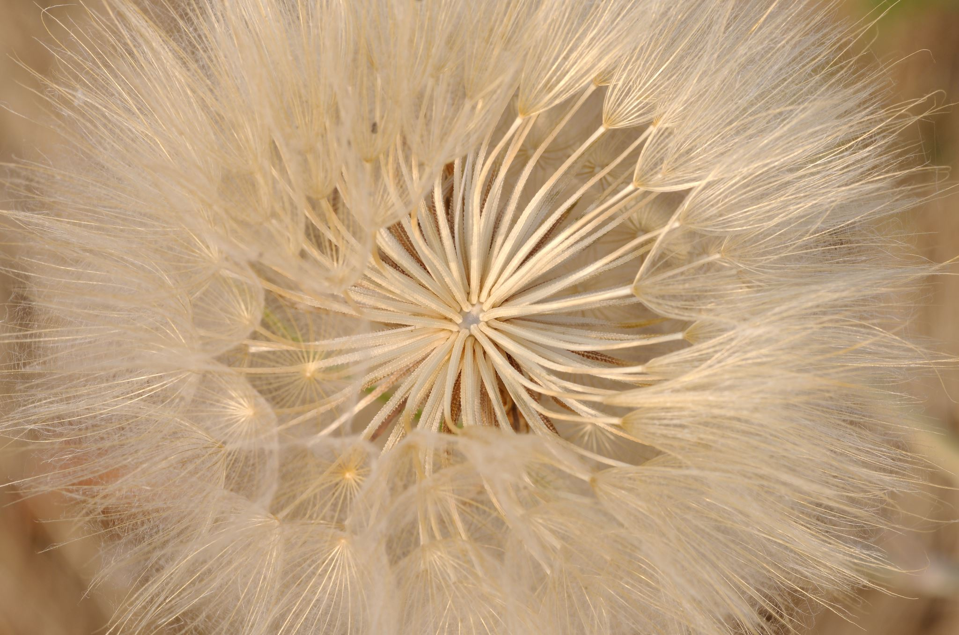

Introduction
AN NAAFA started the company in 2020 with the main moto to do line of work by environment safety manner.
Still today we are moving forward smoothly by giving our customer the feel that we are in our commitment always in every aspect.
In the textile and apparel sector we are doing committed export business in terms of quality, commitment on time delivery and comparative price with our manufacturing unit and indenting unit.
In cotton fiber sector we have better sources to provide quality product as we do directly with the Jenners from Pakistan, Afghanistan & India.
In trims we do from our own factory which is OEKO-TEX certified.
On imported fabric we have Inditex and several customers of USA & germany buyers approved mill for knit, woven and denim.
We also doing some agricultural product trading like Rice, Dates, Mango, Orange, Coffee from Pakistan farmers.
In civil work we have good source of stone and sands to provide our customers by ensuring the actual quality.
Our young energetic professional team ensuring best communication & service for our honorable buyer that they required for smooth business to move forward and keep trust to do business ethically.

Slide 3


Concerns
AN NAAFA Fabrics Ltd.
Basic Textile Mills
AN NAAFA Cotton & Fiber
AN NAAFA Core Sourcing
AN NAAFA Apparels
AN NAAFA Trims
Super Trims Manufacturing
AN NAAFA Environmental Biotechnology
AN NAAFA Fabrics Limited: Export oriented fashion fabric manufacturer going to start manufacturing as limited company within 2026. It was registered in Bangladesh Joint Stock on 2020.
Basic Textile Mills: Export oriented woven fabric manufacturer working for Europe, Japan & USA customers from 2018.
AN NAAFA Cotton & Fiber: Sudan, Pakistan, Afghanistan & India origin cotton trading unit. Also provide cotton waste, yarn waste, comber noil, hosiery waste, polyester waste, Blue yarn waste & denim waste from Pakistan.
AN NAAFA Core Sourcing: Sourcing hub for yarn, fabric, chemicals, stone, sand, imported food like mango, dates fruit, dates coffee, apple, orange, rice & IT product from Pakistan, China, India, Vietnam, Indonesia, Thailand, Malaysia, Sudan & Dubai.
AN NAAFA Apparels: Sourcing hub for apparels product of Woven, Denim, Knit & Sweaters.
AN NAAFA Environmental Biotechnology: From 2025 start the journey to develop biodegradable product. Started to work on ecological product like JUTE manufactured bag to export. This is 100% biodegradable and Bangladesh origin product.
AN NAAFA Trims: Sourcing hub of apparel's trims and accessories.
Super Trims Manufacturing: Manufacturer of drawcord, drawstring, Jacquard Elastic, Woven Elastic, Fancy elastic, Silicon Ending, Rubber Drawcord, PO Belt, Leather Belt, Bany Belt. We have both knitting & dyeing facilities & mill is OEKO-Tex certified.

Slide 4
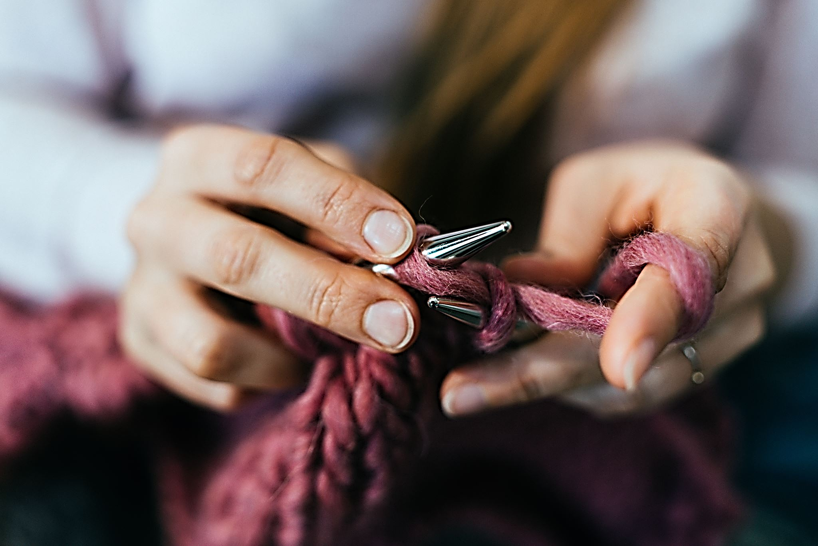
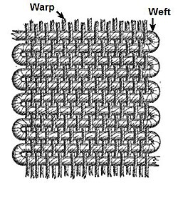

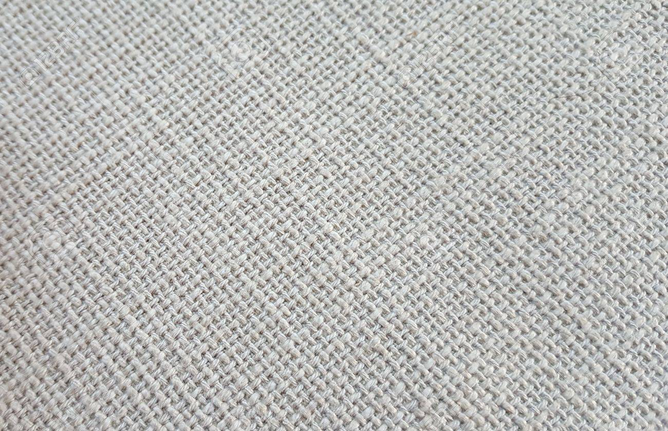
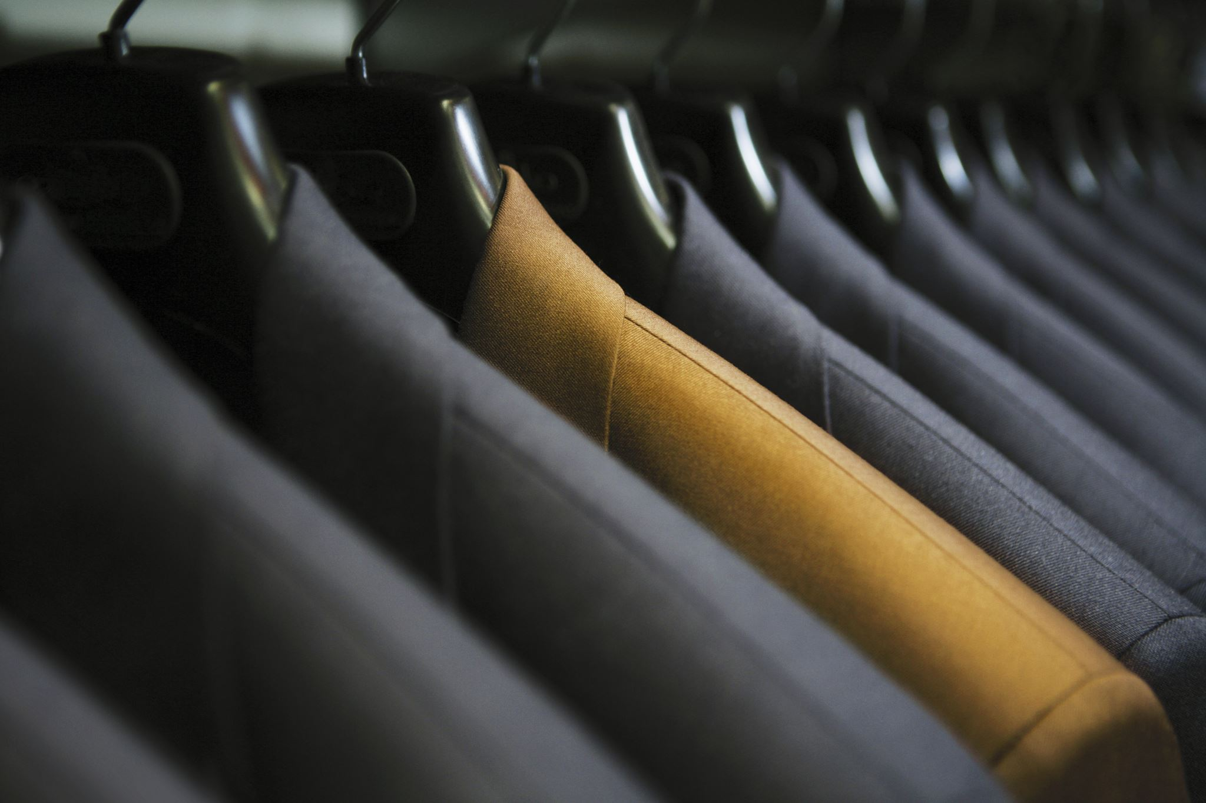
BASIC TEXTILE MILLS
BASIC TEXTILE MILLS started woven fabric manufacturing from 2018.
This is the first manufacturing unit of the group.
65 rapier looms is running continuously for the export oriented woven fabric manufacturing.
The fabric we are doing production is from 7 NE to 40 NE.
In design or weave we are doing dobby, sateen, matt weave, oxford, calico, RIB STOP along with regular twill and canvas.
In dyeing we work with associate mills for solid dyeing and yarn dyed fabrics who are approved by the customers like H&M, UNIQLO, Inditex, G-Star RAW, Hugo Boss, Levi’s, GAP, Walmart, M&S, NEXT, Primark, Celio.
We also doing the reactive, pigment and digital print woven fabric.

